Slide 1

Dept.- CSE(Artificial Intelligence and Machine Learning)
Batch – A3
STUDENT GRIEVANCE APPLICATION
GUIDE NAME/ DESIGNATION: Mr. R. Praveen Kumar /Associate Professor
By
G. Sai Sanjay (20891A6613)
A. Vivek Vardhan (20891A6601)
P. Sushmitha Ramana(20891A6637)
S. Sai Pavan (20891A6660)

Slide 2
ABSTRACT:
The "Student Grievance Application" is designed to streamline and improve the process of addressing student grievances within a college. This application offers students a user-friendly platform to submit complaints, enabling efficient resolution while promoting transparency and accountability in the institution. The application enhances the college's ability to collect, analyze, and respond to student concerns, ultimately improving the overall educational experience.

Slide 3
INTRODUCTION:
"Student Grievance System," a solution designed to revolutionize the way we address and resolve student concerns within our educational institution.
This project aims to streamline the grievance resolution process by leveraging a mobile application developed using Java/XML and Firebase as the backend database.
By providing distinct modules for administrators, faculty, and students, we are enhancing transparency, accountability, and efficiency in handling grievances..

Slide 4
LITERATURE SURVEY:
[1] K. Aravindhan, K. Periyakaruppan, K. Aswini, S. Vaishnavi and L. Yamini, "Web Portal for Effective Student Grievance Support System," 2020 6th International Conference on Advanced Computing and Communication Systems (ICACCS), Coimbatore, India, 2020, pp. 1463-1465, doi: 10.1109/ICACCS48705.2020.9074344.
This paper aims to develop and implement a web-based system that allows students to submit and manage their complaints online, and provides a platform for staff members to handle and resolve these issues in a timely and fair manner. Their framework and methodology of the system, which consists of two parts: one for students and another for administrators. The system uses HTML, CSS, JavaScript, PHP, and MySQL as the main technologies for frontend and backend development. Here a separate committee will be maintaining the website where they will monitor and approve to send the complaints to the respected departments.

Slide 5
LITERATURE SURVEY:
[2] S. shah, S. Jha and P. Sonawane, "Smart Student Grievance Redressal System with Foul Language Detection," 2022 8th International Conference on Advanced Computing and Communication Systems (ICACCS), Coimbatore, India, 2022, pp. 187-192, doi: 10.1109/ICACCS54159.2022.9785119..
This research study focuses on tracking student data and complaints to monitor student performance. It proposes a website built using Django, HTML, Python, and MongoDB, where students can submit grievances. It also addresses concerns related to language quality and hate speech by employing deep learning and machine learning techniques. It trained models on 11,325 tweets and evaluated them using metrics like F1 score, recall, and precision. The LSTM model outperformed others with metrics values of 0.884, 0.84, and 0.86.

Slide 6
LITERATURE SURVEY:
[3] S. Kuhan and L. K. J. Grace, "Design and Implementation of Students Grievance and Database," 2023 2nd International Conference on Applied Artificial Intelligence and Computing (ICAAIC), Salem, India, 2023, pp. 1065-1068, doi: 10.1109/ICAAIC56838.2023.10141027.
This research study focuses on tracking student data and complaints to monitor student performance. It proposes a website built using JavaScript, HTML, Python, and MySQL, where students can submit grievances. The system notifies the relevant department and allows students to track their complaint's status. The study also addresses concerns related to language quality and hate speech by employing deep learning and machine learning techniques. It trained models on 11,325 tweets and evaluated them using metrics like F1 score, recall, and precision. The LSTM model outperformed others with metrics values of 0.884, 0.84, and 0.86.

Slide 7
LITERATURE SURVEY:
[4] Patel, Viral & Kapadia, Daanyaal & Ghevariya, Deval & Pappu, Shiburaj. (2020). All India Grievance Redressal App. Journal of Information Technology and Digital World. 2. 91-99. 10.36548/jitdw.2020.2.002.
This paper about "All India Grievance Redressal App" is a state-of-the-art digital platform developed to address the diverse needs and concerns of citizens across India. This mobile application serves as a unified and accessible channel for individuals to report grievances, seek resolutions, and engage with government authorities at various levels. This Application will give easy Access for people to put their complaints to the Government. Technologies used are JavaScript, MongoDB .

Slide 8
LITERATURE SURVEY:
[5] Venkatesan, Satheeswaran & R, Arjun & A, Nidhin & C., Pranav. (2020). State-Level Students Grievance Support System. International Journal of Scientific Research in Computer Science, Engineering and Information Technology. 364-367. 10.32628/CSEIT2062111.
This paper gives an optimized solution to address delays in student services, improving the student-university relationship. It introduces an e-complaint web-based system to replace the manual processing prevalent in committees and college administration. This State-level support system simplifies complaint submission and organization. Students can easily categorize and post complaints, while administrators can efficiently sort them using keywords.

Slide 9
EXISTING SYSTEM:
The physical suggestion box is a tangible container, typically made of metal and placed in a central or accessible location on the college.
It serves as a traditional method for students, faculty, and staff to submit feedback, complaints, suggestions, or grievances anonymously or with limited identification.

Slide 10
PROPOSED SYSTEM:
It replaces or complements the existing physical suggestion box with a user-friendly mobile application, accessible through smartphones and tablets.
The application allows students, faculty, and staff to submit grievances and feedback quickly and conveniently, enhancing the accessibility and ease of communication

Slide 11
SYSTEM REQUIREMENTS:
SOFTWARE REQUIREMENTS:
• Windows 7 or above
• Android SDK
• Android Studio
HARDWARE COMPONENTS:
• Processor – Intel i5 or equivalent
• Hard Disk – 10 GB
• Memory – 4GB RAM

Slide 12
SYSTEM MODULES:
ADMIN Module:
Add Faculty / Add Coordinator
View Faculty / View Coordinator
View Complaints
View Solved Complaints
Delete Complaints
Delete Faculty

Slide 13
SYSTEM MODULES:
EXECUTIVE Module:
view complaints
update complaint status
STUDENT Module:
Registration
Post Complaint
View complaints
Delete Complaint

Slide 14
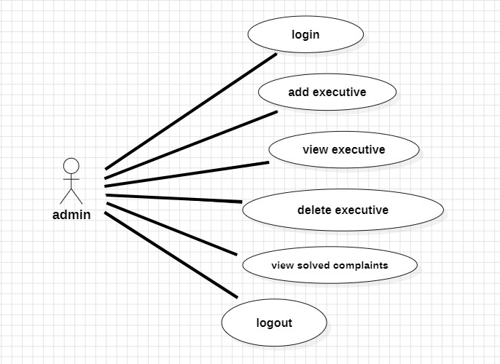
SYSTEM DESIGN:
Use Case Diagram
Admin Use case

Slide 15
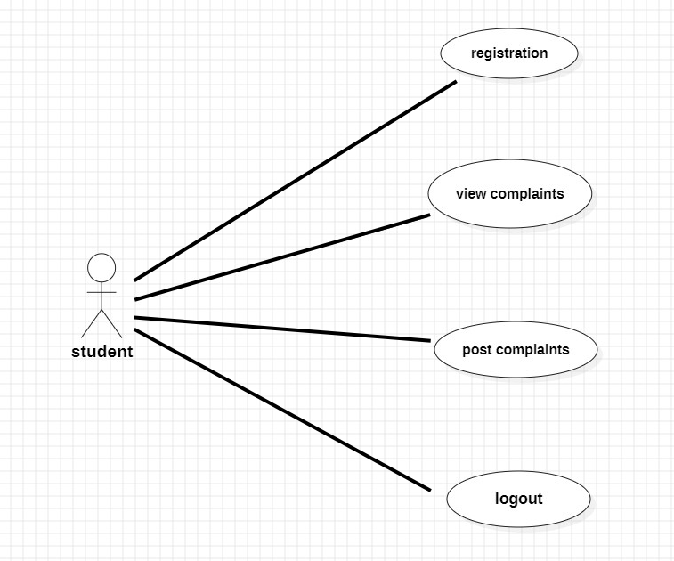
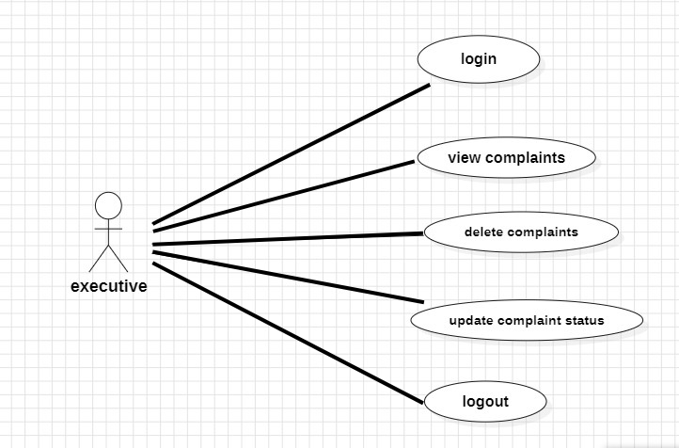
SYSTEM DESIGN:
Use Case Diagram
Executive Use case
Student Use case

Slide 16
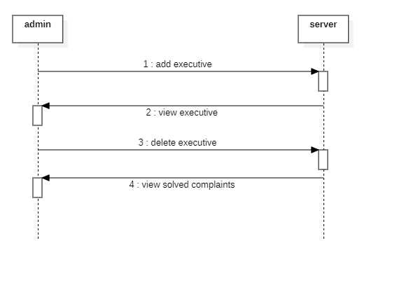
SYSTEM DESIGN:
Sequence Diagram

Slide 17
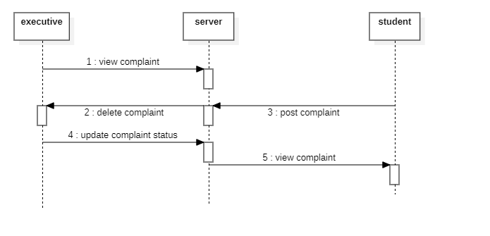
SYSTEM DESIGN:
Sequence Diagram

Slide 18
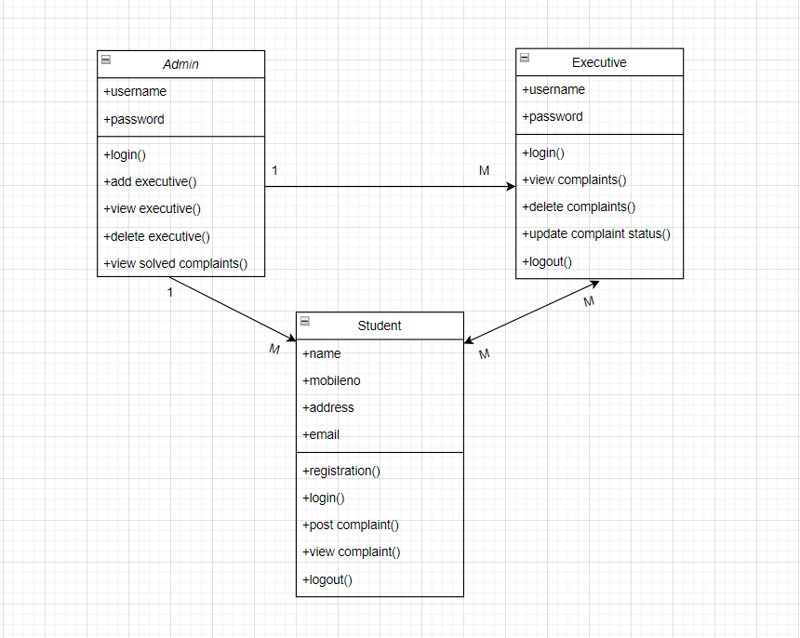
SYSTEM DESIGN:
Class Diagram

Slide 19
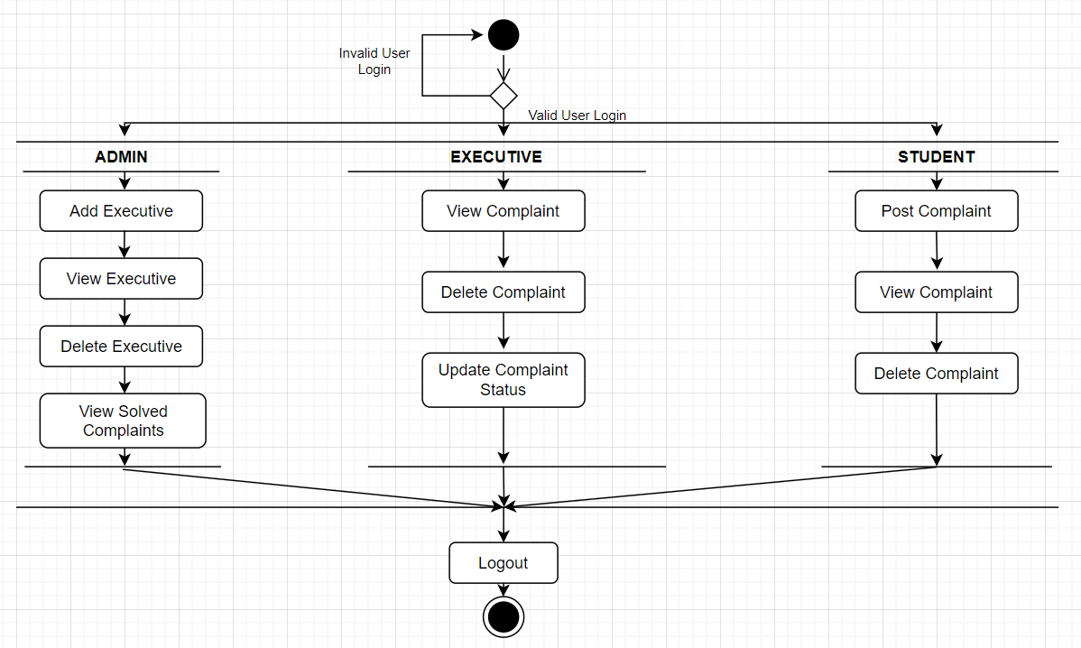
SYSTEM DESIGN:
Activity Diagram

Slide 20
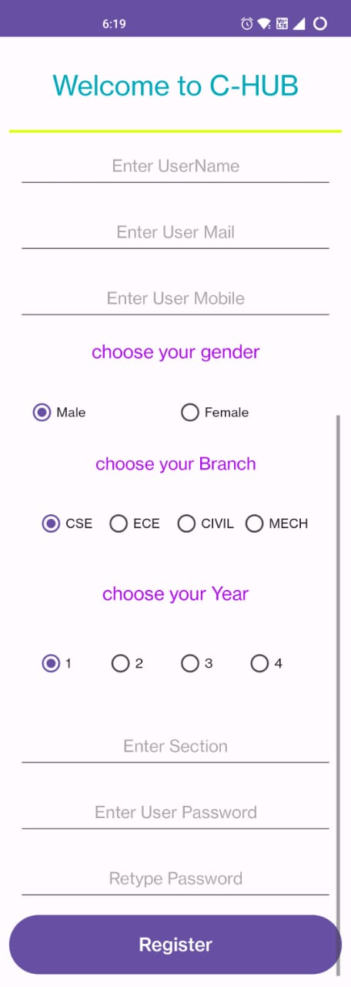
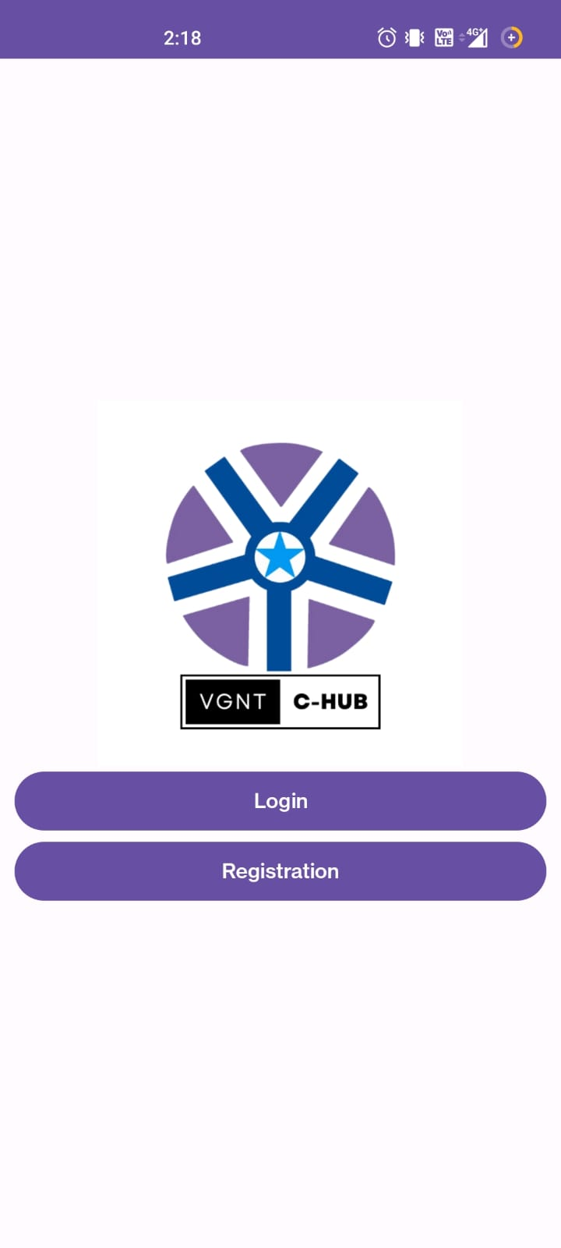
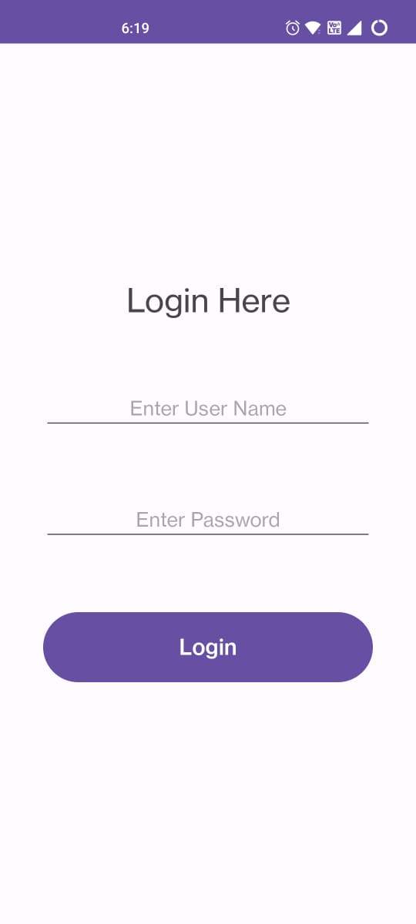
OUTPUT USER INTERFACE:

Slide 21
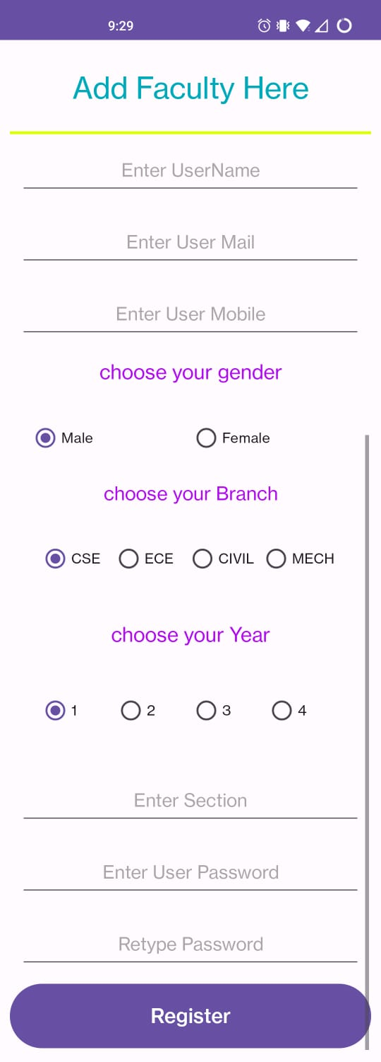
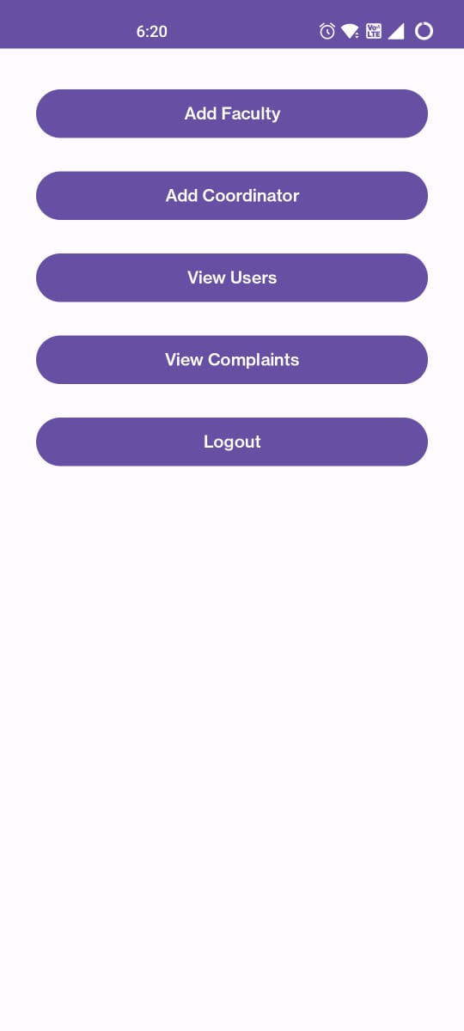
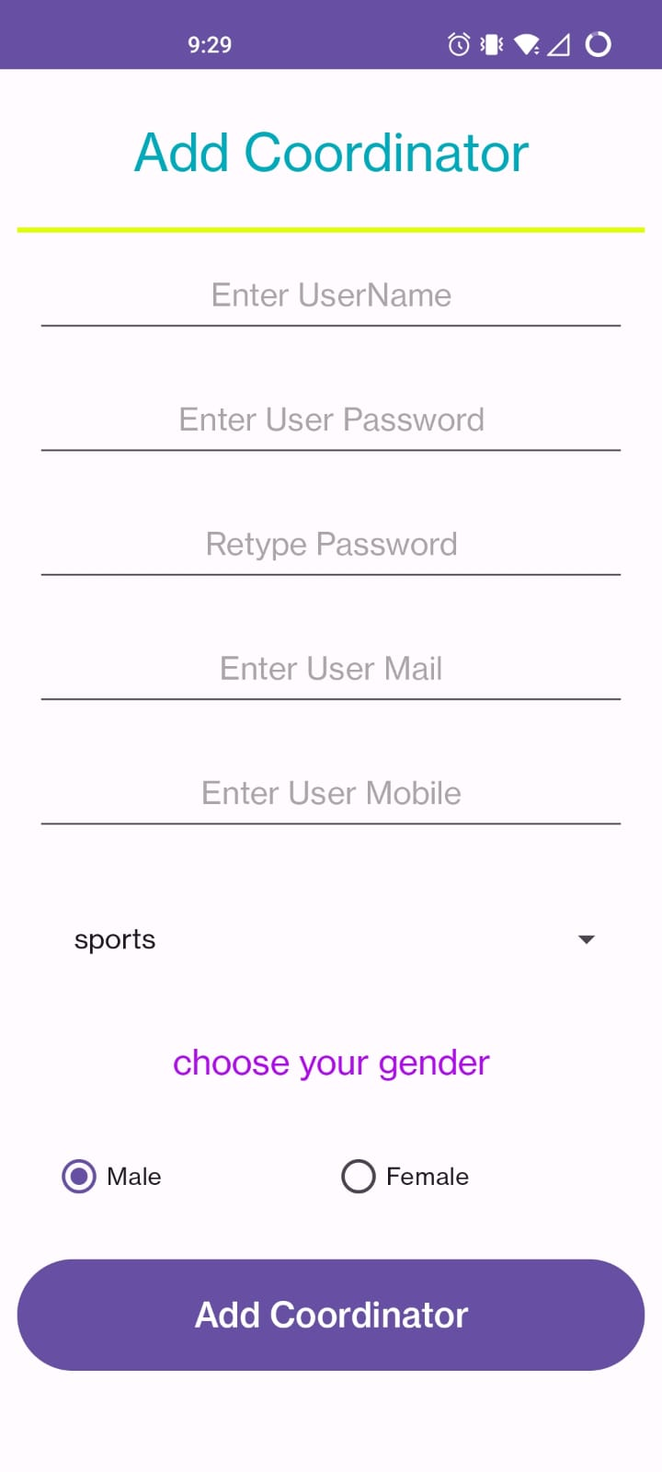
OUTPUT USER INTERFACE:

Slide 22
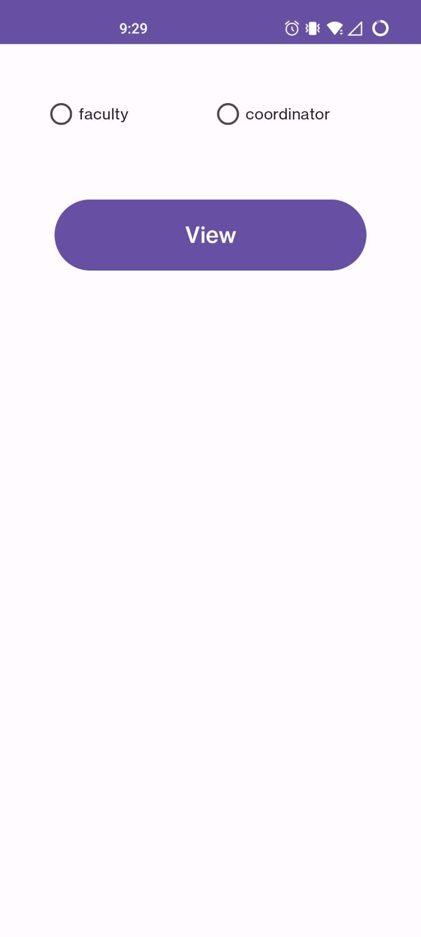
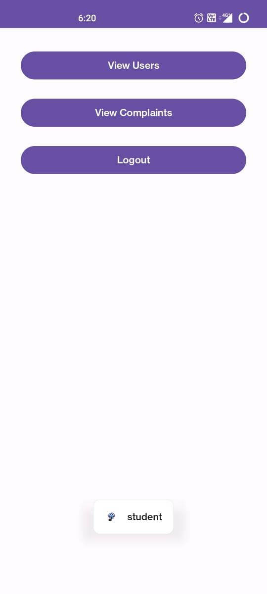
OUTPUT USER INTERFACE:

Slide 23
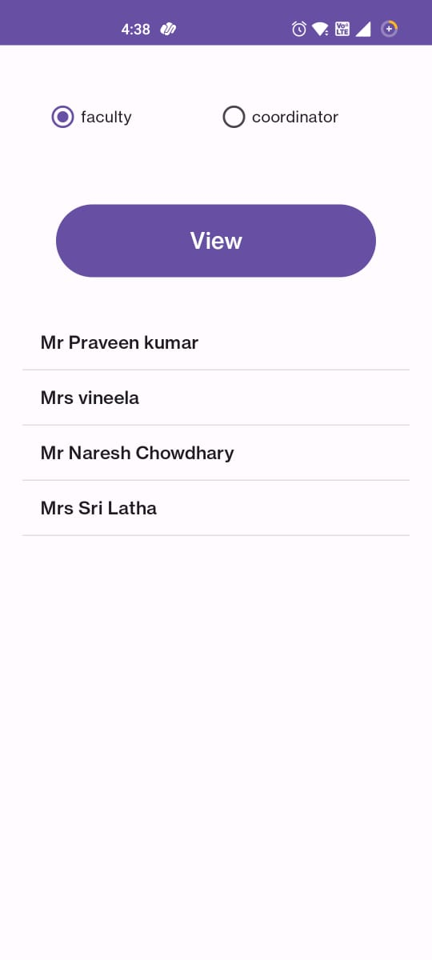
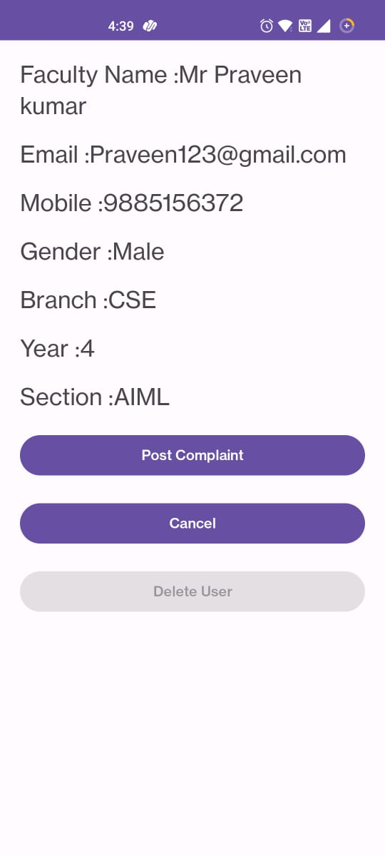
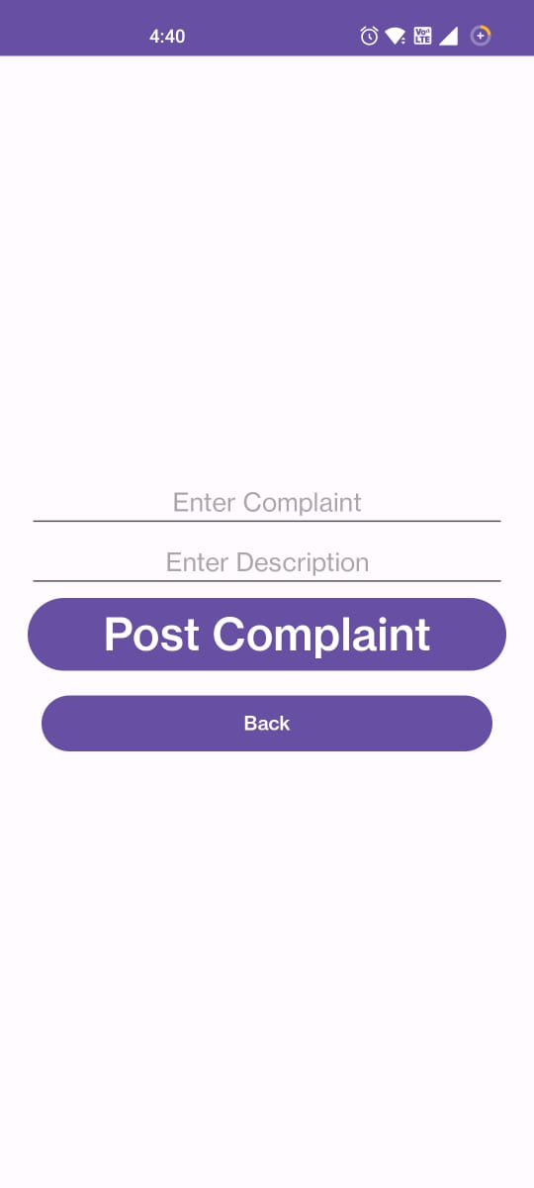
OUTPUT USER INTERFACE:

Slide 24
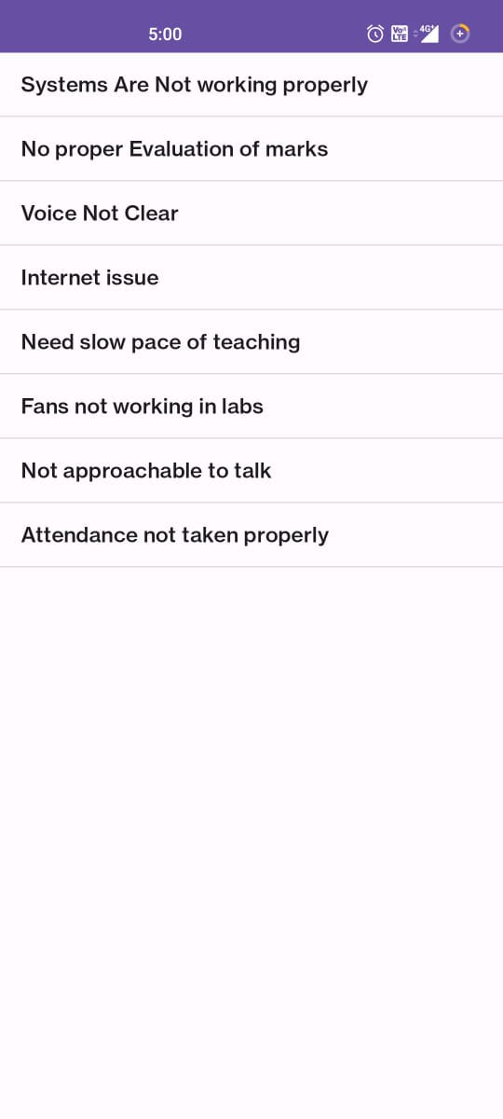
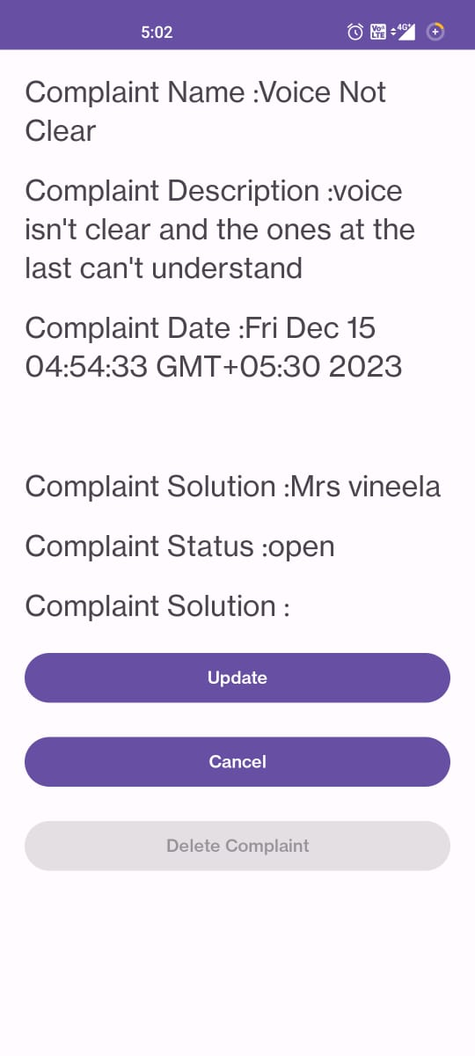
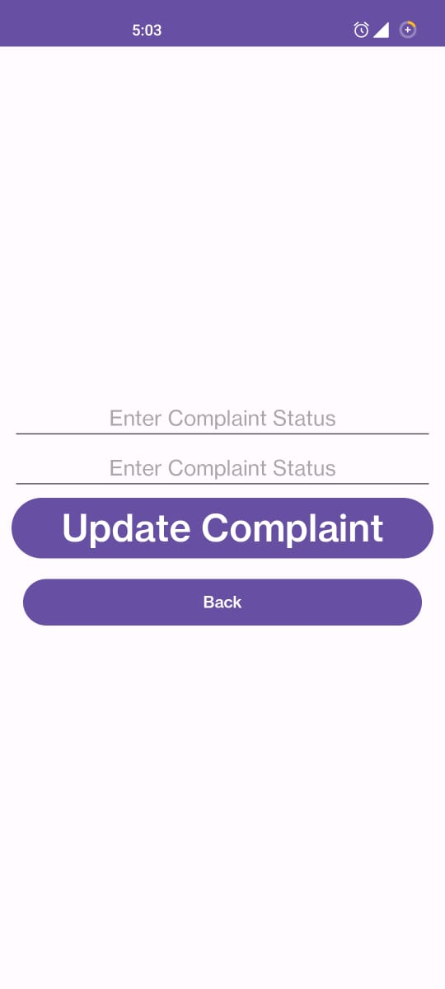
OUTPUT USER INTERFACE:

Slide 25
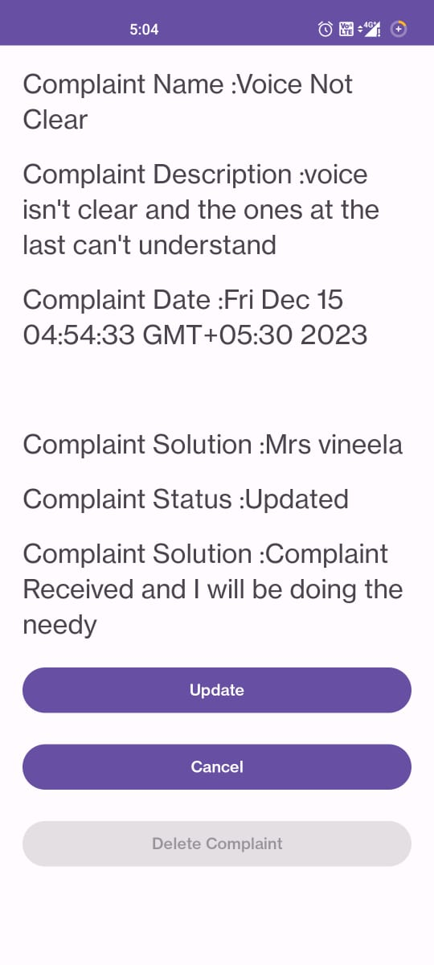
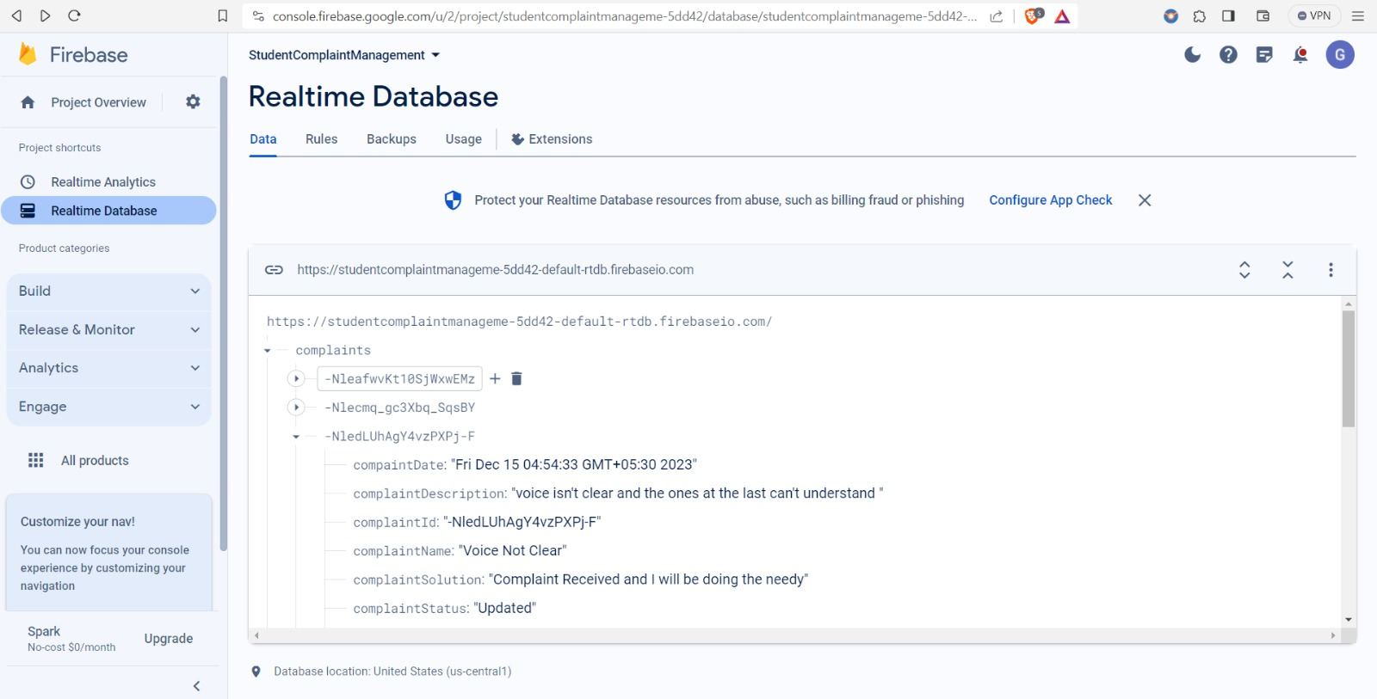
OUTPUT USER INTERFACE:
Database View

Slide 26
CONCLUSION:
The successful implementation of the Student Grievance System, signifies a significant leap forward in addressing student concerns within our institution. This streamlined system ensures efficient complaint submission, transparent resolution tracking, and user-friendly interfaces for administrators, executives, and students. The innovative approach not only expedites grievance handling but also fosters transparency, accountability, and an overall improved educational experience.

Slide 27
FUTURESCOPE:
The future scope for the Student Grievance System involves introducing user-centric features such as password change functionality, a robust notification system for real-time updates, and enhanced user profile management.
Ensuring mobile accessibility features and exploring the incorporation of machine learning for predictive analytics will contribute to the system's evolution, adapting to the dynamic needs of our educational community.

